Slide 1
Practical Python Programming for Social Science Scholars
An introduction to data gathering, cleaning, and analysis in the python programming language

Slide 2
Who Am I?
PhD Student in Science and Technology Policy
Impact of emerging technologies on US public policy.
Self-driving vehicles, artificial intelligence, etc.
Interest in the power of computer programming in public policy analysis
Computer programmer at Accenture and Deloitte for 3 years prior to starting my PhD
Ran 3 consecutive semester-long workshops entitled Practical Python Programming for Social Science Scholars

Slide 3
The Funniest Line of Text in Social Science Research Software
So many tools exist to analyze and/or visualize data:
STATA, SPSS, SAS, R, and Gephi, just to name a few
However, when you read through the instructions, one step is always the same:
Import Your Spreadsheet

Slide 4
What Is Python?
Introduced February 1991 bv Guido van Rossum
Important features:
Platform Independent
Widely used
Flexible
Why Python?

Slide 5
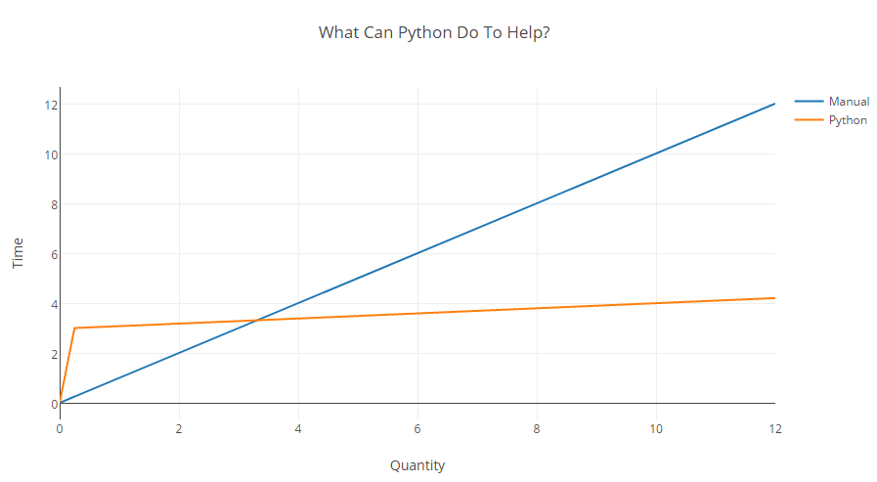
Why Python?

Slide 6
Python vs. R: What’s the Deal?
Common question: is Python “better” than R?
Many answers to that question
A few facts:
A 2015 poll of industry experts in the data sciences by O’Reilly put Python usage at 51% and R usage at 52%
High-frequency traders on Wall Street, a profession which utilizes perhaps the largest data sets of any in the world, nigh-universally prefer Python over R
Statisticians nigh-universally prefer R over Python

Slide 7
Python vs. R: What’s the Deal?
My Opinion:
R is brilliant at what it was designed to do – regression analysis
R’s syntax is terrible – not intuitive and very finicky
Social science scholars have more to worry about than just regression – many of which go beyond what R was designed to do.

Slide 8
The Four Core “Data Tasks” of the Social Sciences
Gather Data
Parse/Convert Data
Analyze Data
Visualize Data (not discussed here)

Slide 9
Gathering Data
Downloading documents or spreadsheets
Example: Department of Defense PDF Documents
Accessing online databases
Examples: NY Times, Twitter, Google Maps
Extracting raw website data
Example: DOHA Clearance Data

Slide 10
Parsing Data
Merging/converting files
Example: TXT to Spreadsheet, PDF to TXT
Fixing data consistency problems
Example: Fixing the DOHA Data

Slide 11
Analyze Data
Many tools already exist for performing all types and variants of regression analysis.
Nevertheless, there are also powerful analytical capabilities that Python can do with textual data
In the past few years, there have been some fascinating advances in textual analysis:
Positive/Negative Sentiment Analysis
Emotional Sentiment Analysis
Political Sentiment Analysis
Key Word/Phrase Detection

Slide 12
Clearer Now?

Slide 13
OK, But How Difficult Is This To Learn?
There are certainly problems for social scientists attempting to break into the field
Good news is, you don’t need to become a computer science master
Materials here will be of great assistance

Slide 14
Frequently Asked Questions
What background do I need to learn Python?
Can I do task X with Python?
Can I teach myself? What if I have a problem?
Feel free to email me @ jlee17@gmu.edu!

Slide 15

Questions?

